Slide 1
Microsoft / Intel IoT Camp Train the trainer
Content Overview and Best Practices for a Great Event

Slide 2
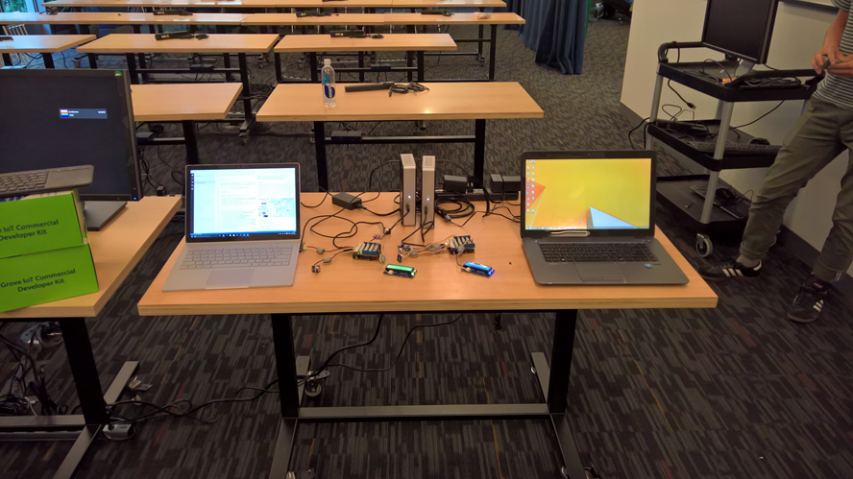
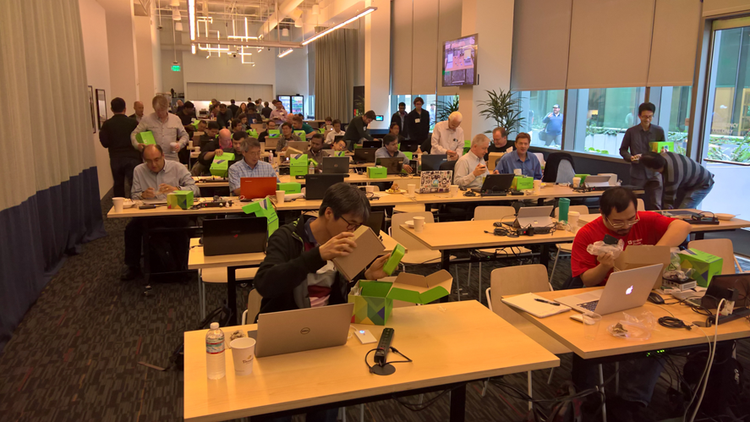
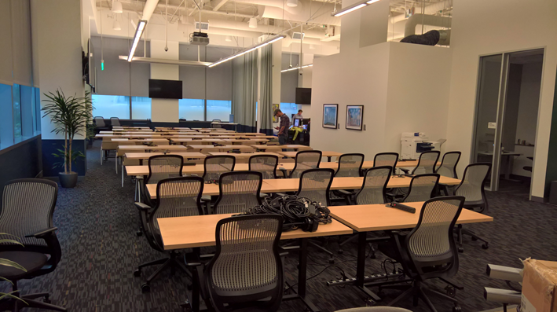
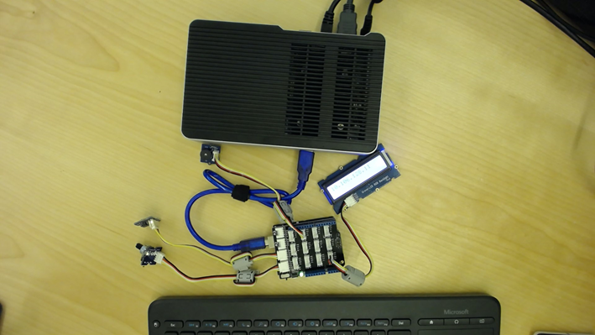
This is a fun event if we run it right

Slide 3
Content overview

Slide 4
Lab content & slides on github
Latest Release is at http://aka.ms/MicrosoftIntelIoTCamp
Contains a downloadable MicrosoftIntelIoTCamp.zip file
Attendees should download the .zip file and extract it locally
Zip file contains all the lab files, assets, instructions, solutions, etc.
Lab Source is on GitHub : http://github.com/dxcamps/MicrosoftIntelIoTCamp
If you want to make fixes to the lab, fork it and issue a pull request.

Slide 5
Presentations
Main Microsoft Presentation: Slides/MicrosoftAzureIoTOverview.pptx
For the most part, this is the exact same deck presented by Cameron Skinner and Doug Seven at BUILD 2016. You can watch the presentation here: //BUILD 2016 Session B815
NOTE: THE DEVICE MANAGEMENT FEATURES HAVE CHANGED. FEEL FREE TO TRIM THIS SESSION DOWN TO JUST FYI, OR UPDATE WITH MORE CURRENT SLIDES.
There is a “Microsoft Intel IoT Camp Gateway Overview.pdf“ from Intel that cover’s Intel’s IoT approach

Slide 6
The Lab
This is a comprehensive lab with a LOT of steps
The good part is that attendees get exposed to a LOT of Azure
The bad part is that it takes a long time and many attendees won’t complete it in the time
Ensure optimum time for the labs by keeping the presentations to a minimum
Lab instructions are in /HOLs/readme.htm (or .md in the source)

Slide 7
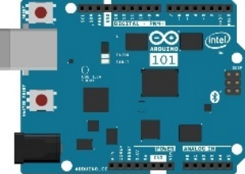
Lab Architecture
Resource Group <name>group
Development Workstation (Windows / OSx / Linux)
GET / POST
SEND / RECEIVE
SEND CLOUD-TO-DEVICE MESSAGES
App Service Plan <name>plan
Web App <name>web
IoT Hub <name>iot
SQL Server
<name>sql
PowerBI Embedded Workspace Collection <name>collection
PowerBI Embedded Workspace
Dynamically generated guid
Report TemperatureChart
Router w/ Internet Access
SQL Db
<name>db
AZURE RESOURCES
LOCAL RESOURCES
OUTPUT
QUERY
RENDER
Stream Analytics
<name>job
DIRECT QUERY
INPUT
SEND / RECEIVE
Intel NUC / IoT Gateway
Arduino 101 & Grove Base Shield
OUTPUT
Function App
<name>functions
Buzzer
Event Hub Namespace
<name>ns
Function TempAlert
Event Hub <name>alerts
Storage Account <name>storage
Temperature Sensor
RECEIVE
SEND CLOUD-TO-DEVICE-MESSAGES
READ / WRITE
Rotary Angle Sensor
2 Row LCD Display

Slide 8
Lab Architecture
Resource Group <name>group
Development Workstation (Windows / OSx / Linux)
GET / POST
SEND / RECEIVE
SEND CLOUD-TO-DEVICE MESSAGES
App Service Plan <name>plan
Web App <name>web
IoT Hub <name>iot
SQL Server
<name>sql
PowerBI Embedded Workspace Collection <name>collection
PowerBI Embedded Workspace
Dynamically generated guid
Report TemperatureChart
Router w/ Internet Access
SQL Db
<name>db
AZURE RESOURCES
LOCAL RESOURCES
OUTPUT
QUERY
RENDER
Stream Analytics
<name>job
DIRECT QUERY
INPUT
SEND / RECEIVE
Intel NUC / IoT Gateway
Arduino 101 & Grove Base Shield
OUTPUT
Function App
<name>functions
Buzzer
Event Hub Namespace
<name>ns
Function TempAlert
Event Hub <name>alerts
Storage Account <name>storage
Temperature Sensor
RECEIVE
SEND CLOUD-TO-DEVICE-MESSAGES
READ / WRITE
Rotary Angle Sensor
2 Row LCD Display

Slide 9
Tips for a good event

Slide 10
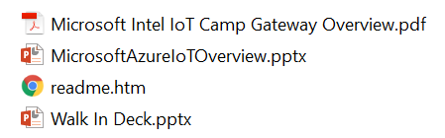
I added a walk-in deck
CUSTOMIZE THE EVAL SLIDE WITH YOUR EVAL DETAILS

Slide 11
WELCOME to the Microsoft & Intel IoT Camp!
Come on it, find a seat, and get comfortable!
We have a great day planned!
8:30am | Registration / Welcome
9:00am | Introduction to Microsoft Azure IoT Services
10:00am | Introduction to the Intel IoT Gateway
11:00am | Hands-On-Lab
12:00pm | Lunch Served
Afternoon | Hands-On-Lab Continues
4:30pm | Make sure to complete your Eval!
5:00pm | End of Event

Slide 12
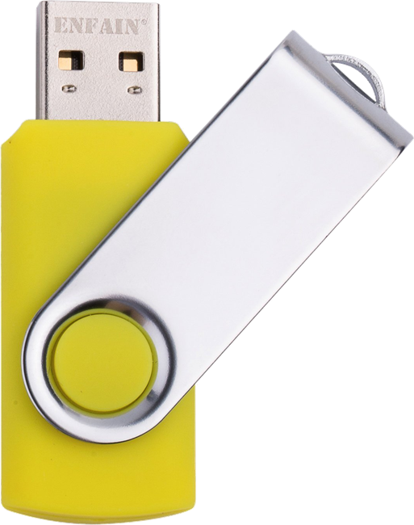
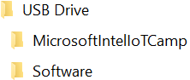
USB STICKs
There are Yellow USB Sticks being passed around.
Please copy, not move, the contents to your computer and pass the stick on to your neighbor.
PLEASE DO NOT TAKE THE USB STICKS!
We got to a lot of effort to make these, please help make them available to future attendees!

Slide 13
PLEASE CONNECT TO WIFI
PLEASE DO NOT CONNECT YOUR LAPTOP TO THE ETHERNET CABLES AT YOUR TABLE. THE ETHERNET CONNECTION IS REQUIRED BY THE INTEL GATEWAY DEVICE YOU WILL USE IN THE LAB.
SSID: MSFTOPEN
Password: None. Open Browser to Connect
Development Workstation (Windows / OSx / Linux)
MSFTOPEN
Intel NUC / IoT Gateway

Slide 14
Verify your azure subscription
You will need an active Azure Subscription to complete the lab.
You can sign up for a free trial at: http://azure.com/free
If you have already used a free trial in the past:
Open a private browser session.
Go to outlook.com and create a new free outlook.com email address
Sign up for the free Azure Trial using that new outlook.com email address
If you have an existing subscription you wish to use you may do so. While the services you will configure in the lab are inexpensive, there are costs associated. You could expect to be billed appx $5 USD per day for normal usage of the services The cost could be higher with excessive usage..

Slide 15
Stay current with the content
We have the latest content for you on the USB drives here at the event, however in the future:
The content is available on GitHub at:
http://github.com/dxcamps/MicrosoftIntelIoTCamp
You can download a a.zip file with the most recent content from:
http://github.com/dxcamps/MicrosoftIntelIoTCamp/releases/latest

Slide 16
GET What you need for the labs…
Now is a great time to setup or install these if you don’t have them already. There are copies of the software on the yellow USB drives…
An active Microsoft Azure Subscription.
Node.js 4.x or later. You can install Node.js from nodejs.org
Visual Studio Code. You can install it from code.visualstudio.com
Git installed and in your system path. Install it from:
git-scm.com/downloads or if you prefer GitHub…
desktop.github.com
Make sure your git global config is setup: git config --global user.name "Your Name“ git config --global user.email "Your Email"

Slide 17
Microsoft & Intel | IoT Camp Attendee Evaluation
Please take a few minutes to answer our short survey BEFORE you leave the event today!
To receive the evaluation link for this event, text MICROSOFT CALI to 878787. By doing so you agree that Microsoft can send you an automated message to this mobile phone.
If unable to access the evaluation through the QR code on your name badge, you can access the evaluation here: http://aka.ms/IoTCampCA
Provide the email you used to register for this event, select the attendee evaluation and complete the evaluation.
Thank you for your feedback!
© 2016 Microsoft Corporation. All rights reserved. Microsoft, Windows, Windows Vista and other product names are or may be registered trademarks and/or trademarks in the U.S. and/or other countries.
The information herein is for informational purposes only and represents the current view of Microsoft Corporation as of the date of this presentation. Because Microsoft must respond to changing market
conditions, it should not be interpreted to be a commitment on the part of Microsoft, and Microsoft cannot guarantee the accuracy of any information provided after the date of this presentation.
MICROSOFT MAKES NO WARRANTIES, EXPRESS, IMPLIED OR STATUTORY, AS TO THE INFORMATION IN THIS PRESENTATION.

Slide 18
troubleshooting

Slide 19
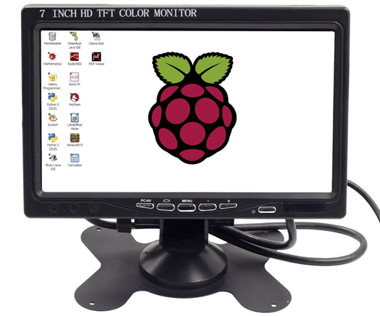
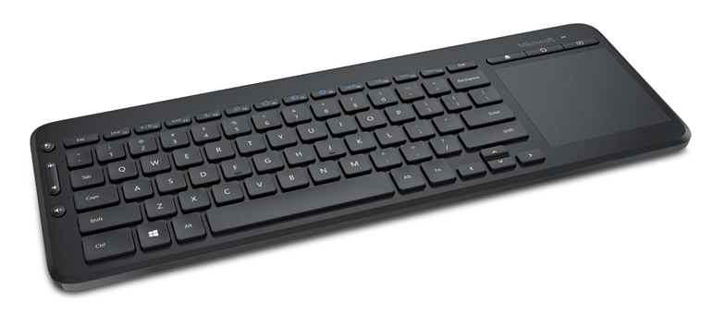
Have and hdmi monitor / keyboard handy for the nucs

Slide 20
The network was the biggest issue
PROBLEM:
The http://your.nucs.ip.address website keeps refreshing and never loads, and you can’t ssh into the NUC even though you can ping it’s IP Address
RESOLUTION:
Just keep rebooting the NUC, waiting up to five minutes before attempting to connect, and try it again. LAME.
Could also put both the laptop and NUC on Wired MSFTOPEN, but that solution is logistically impossible for all attendees.

Slide 21
Network setup issues
PROBLEM:
We had a couple of tables where the Ethernet switches were not plugged into the Wired MSFTOPEN network.
RESOLUTION
Take the time to walk with a laptop to at least one cable on every switch and verify that you can connect to the network

Slide 22
THE NUC IS HOSED
PROBLEM
You may never get an IP Address displayed, you may never connect, or you may not be able to install the packagegroup-cloud-azure package
RESOLUTION
Re-image the NUC. You’ll need and HDMI monitor and keyboard on the NUC to complete this:
Here’s how: http://aka.ms/resetnuc

Slide 23
Random issues
RGB LCD not turning on - Try unplugging the NUC from power to reset the Arduino 101, then plug the power back in to reboot the NUC and Arduino
Iothub-explorer not being in the path – Make sure you have node in the system path, and that iothub-explorer was installed globally (“-g”)
Pay attention to which Azure IoT Hub connection string is needed:
“iothubowner” needed to create the device identity
“service” needed for back-end services (iothub-explorer, stream analytics, web app, function) to communicate with any device
“device” to send-receive messages as a specific device

Slide 24
Random issues (cont’d)
The NUC sometimes appeared to just randomly restart. I never experienced this personally but many attendees mentioned it. I have noticed that the power button is very sensitive so be careful touching it. That said, we may have an issue with the NUC rebooting itself.
Make sure to give the NUC time to boot and load

Slide 25
IoT Logo

Slide 26
arduino

Slide 27
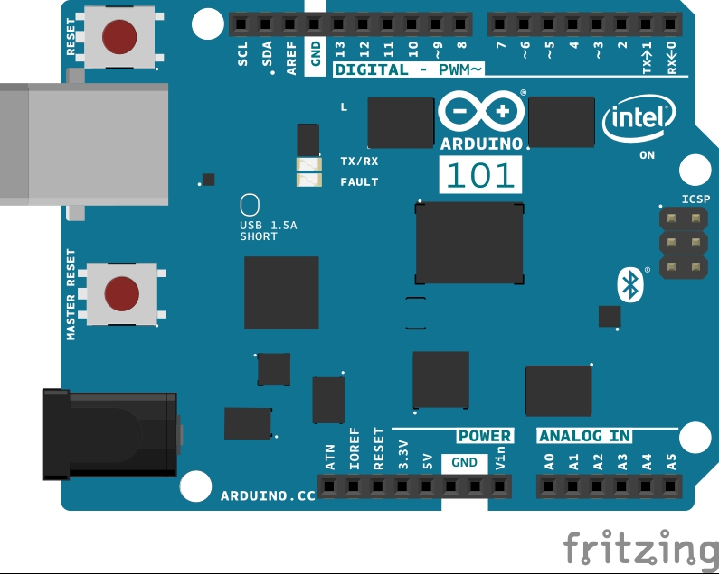
Arduino 101

Slide 28
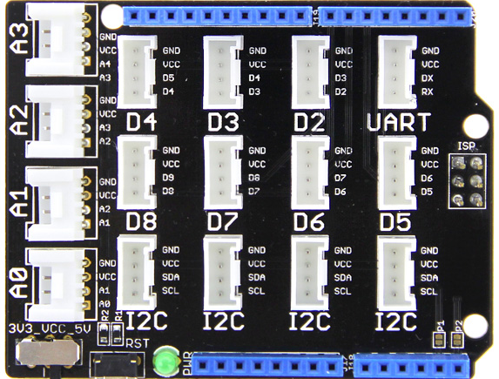
Grove Base Shield

Slide 29
Grove cable & SENSORS

Slide 30
Grove cable & SENSORS

Slide 31
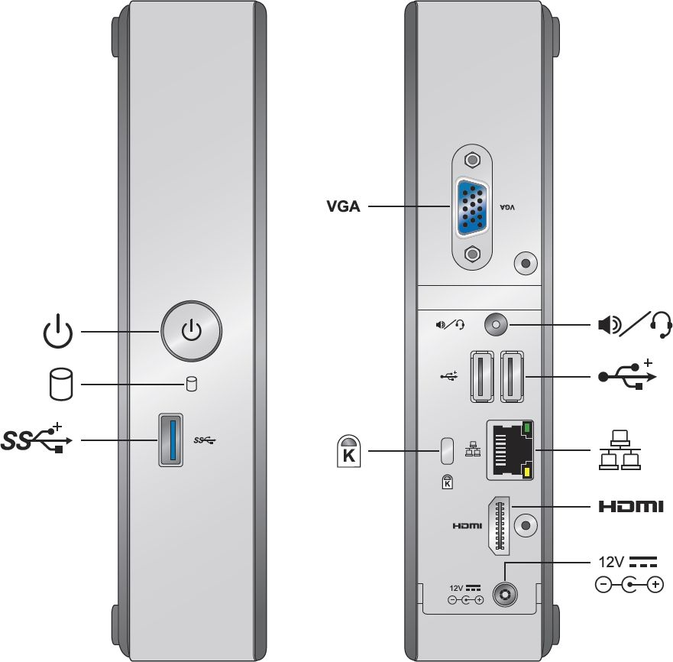
INTEL NUC DE3815TYKE

Slide 32
GALILEO BOARD

Slide 33
RASPBERRY PI

Slide 34
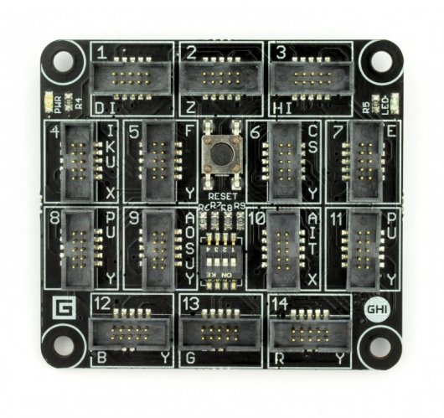
FEZ SPIDER MAIN BOARD

Slide 35
Sparkfun weather shield

Slide 36
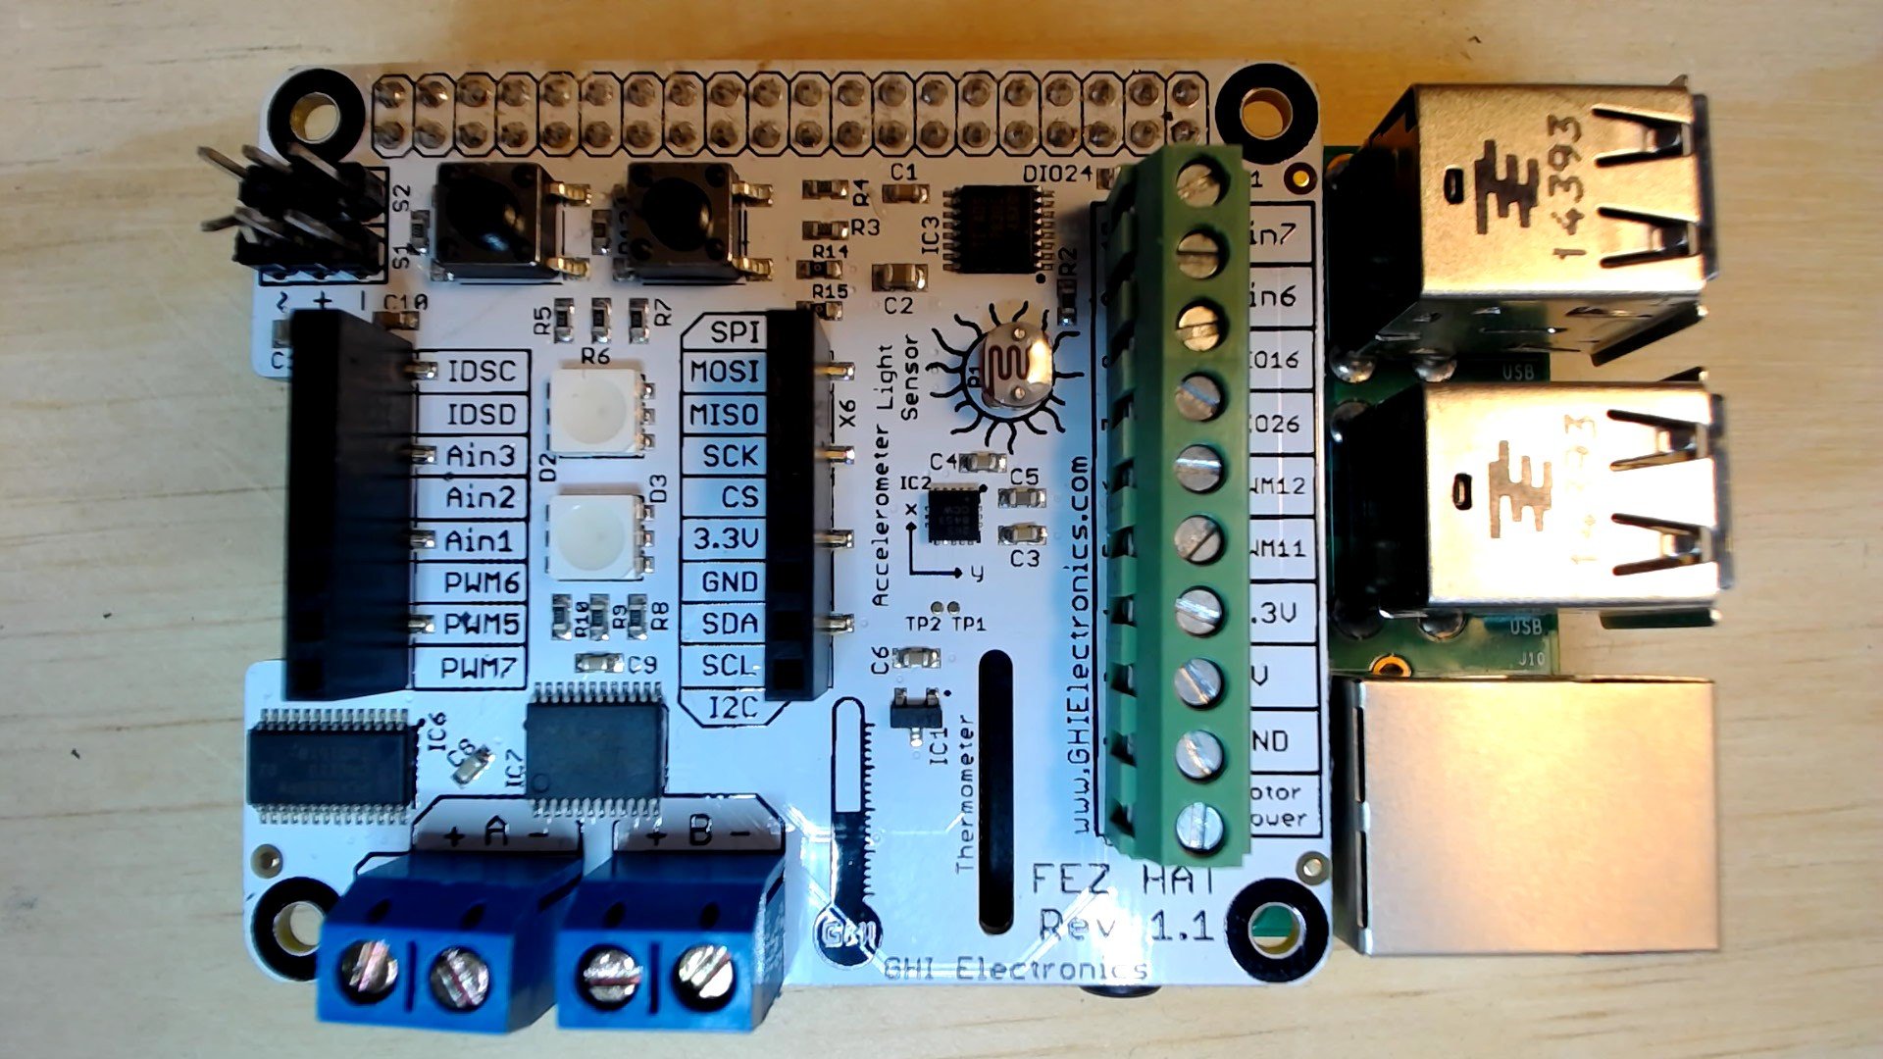
FEZ HAT

Slide 37
Connect the dots azure icons
Event Hubs
Stream Analytics
Storage
(
Azure
Microsoft Azure
Web App
Service Bus
)
Storage blob
Storage table
SQL database
HDInsight
Machine
(
Learning
GitHub code
Git repository
generic
)

Slide 38
LEDs

Slide 39
Resistors
220Ω
1st Digit
2nd Digit
Multiplier
Tolerance
Color | Name | 1st Digit | 2nd Digit | Multiplier | Tolerance
 | Black | 0 | 0 | X1
 | Brown | 1 | 1 | X10 | 1%
 | Red | 2 | 2 | X100
 | Orange | 3 | 3 | X1,000
 | Yellow | 4 | 4 | X10,000
 | Green | 5 | 5 | X100,000
 | Blue | 6 | 6 | X1,000,000
 | Violet | 7 | 7
 | Grey | 8 | 8
 | White | 9 | 9
 | Gold |  |  | X0.1 | 5%
 | Silver |  |  | X0.01 | 10%
330Ω
10KΩ

Slide 40
cables

Slide 41
More cables and adapters

Slide 42

LEDs
Anode (+)
Cathode (-)
Flat Edge
Small Post
Big Post
Long Leg
Short Leg
Vcc (+)
GND

Slide 43
LEDs

Slide 44
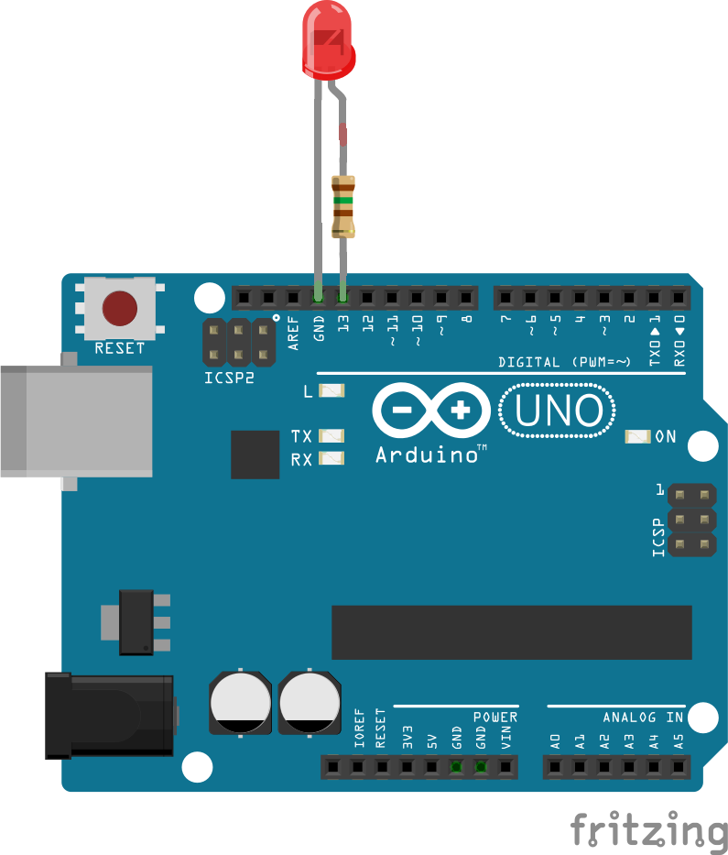
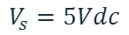
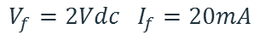
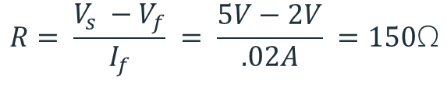
Current limiting resistors
Providing more current than an LED is rated for can destroy the LED. To prevent that, you should use a “Current Limiting” resistor.
To calculate the value of the resistor you need to know the supply voltage (Usually 5V on the Arduino Uno), and the LEDs rated Forward Voltage (the voltage drop across the LED) and Forward Current (the maximum current the LED can handle).
$$V_{f}=2Vdc I_{f}=20mA$$
$$Resistor Value (R)= \frac{Supply Voltage \left(V_{s}\right)−LED Forward Voltage (V_{f}) }{LED Forward Current (I_{f})}$$
$$V_{s}=5Vdc$$
$$R= \frac{V_{s} −V_{f}}{I_{f}} = \frac{5V−2V}{.02A} =150\text{Ω}$$
The Arduino Uno has a built in current limiting resistor on Pin 13. If you use Pin 13 to power your LED you can use it without a separate resistor.

Slide 45
Resistors
220Ω
1st Digit
2nd Digit
Multiplier
Tolerance
Color | Name | 1st Digit | 2nd Digit | Multiplier | Tolerance
 | Black | 0 | 0 | X1
 | Brown | 1 | 1 | X10 | 1%
 | Red | 2 | 2 | X100
 | Orange | 3 | 3 | X1,000
 | Yellow | 4 | 4 | X10,000
 | Green | 5 | 5 | X100,000
 | Blue | 6 | 6 | X1,000,000
 | Violet | 7 | 7
 | Grey | 8 | 8
 | White | 9 | 9
 | Gold |  |  | X0.1 | 5%
 | Silver |  |  | X0.01 | 10%
330Ω
10KΩ

Slide 46
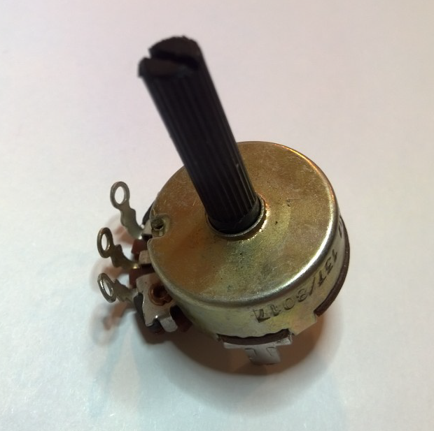
Potentiometer – variable resistor

Slide 47
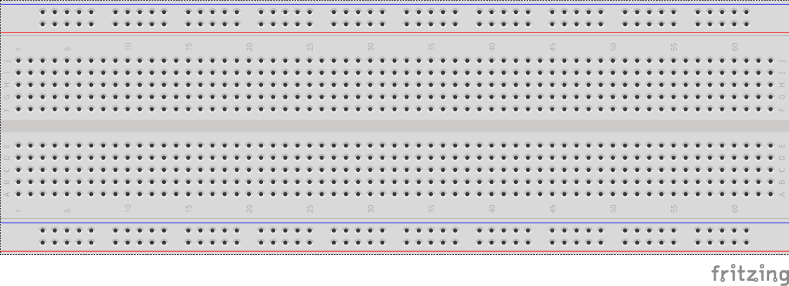
breadboards
Breadboards offer a great way to prototype circuits. The provide a number of “buses” for connecting both power and components.
Power buses run the entire horizontal length
Component buses give you easy ways to connect pins together

Slide 50
Micro SD Cards
Font: Segoe UI Semibold

